Slide 1
Explainable AI – An Introduction
Dr. Chathura Rajapakse
Department of Industrial Management
Faculty of Science
University of Kelaniya

Slide 2
The Black-Box Problem
Key Problem
Modern machine learning prioritizes predictive performance over transparency.
Complex algorithms achieve outstanding accuracy but hide their decision logic inside millions of parameters.
WHY INTERPRETABILITY?
In high-stakes applications, unexplainable model failure poses critical risks:
  • Medical Diagnosis (life safety)
  • Credit Scoring (financial loss)
  • Autonomous Driving (legal liability)

Slide 3
Key Goals of Explainable AI (XAI)
01
TRUST
Verifying that predictions rely on legitimate domain logic rather than spurious correlations.
02
DEBUGGING
Identifying where, how, and why a model makes systematic errors on edge cases.
03
FAIRNESS & AUDITING
Ensuring decisions do not discriminate based on protected attributes.

Slide 4
The Accuracy vs. Interpretability Trade-Off
Model Type | Examples | Interpretability | Predictive Power
Glass-Box (Intrinsic) | Linear Regression, Decision Trees, Logistic Regression | Very High | Moderate
Ensemble Models | Random Forest, XGBoost, LightGBM | Moderate | High
Deep Learning | Convolutional Nets, Transformers | Low | Very High

Slide 5
Intrinsic Interpretability
LINEAR & LOGISTIC REGRESSION
Direct Mathematical Transparency
Each feature coefficient directly represents the expected change in outcome per unit increase in feature value.
DECISION TREES
Explicit Human Logic Rules
Decision rules follow explicit IF-THEN conditional splits that map directly to human logic.

Slide 6
Scopes of Explanation: Global vs. Local
GLOBAL INTERPRETABILITY
Overall Dataset Model Logic
Understanding overall logic and behavior across the entire dataset.
Key Question: "Which features drive predictions overall?"
LOCAL INTERPRETABILITY
Single Prediction Explanations
Explaining why the model made a specific decision for one individual data point.
Key Question: "Why was this specific loan application rejected?"

Slide 7
Permutation Feature Importance
CORE CONCEPT
Measures how much model performance decreases when a feature's values are randomly shuffled.
INTUITION
• High Impact:
If shuffling breaks model accuracy, the model relied heavily on that feature.
• Low Impact:
If performance stays unchanged, the feature was largely ignored.

Slide 8
LIME: Local Interpretable Model-agnostic Explanations
HOW LIME WORKS
LIME builds a simple, interpretable model (like linear regression) that mirrors the complex model's behavior only in the immediate neighborhood of a single prediction point.
GEOMETRIC ANALOGY
Imagine a complex topological map with winding curves.
If you zoom in extremely close to one specific point, the surface looks flat. LIME draws a straight line across that local flat surface.

Slide 9
SHAP: Game-Theoretic Interpretability
SHAP CONCEPT
SHAP adapts Shapley Values from cooperative game theory to measure feature contribution.
GAME THEORY ANALOGY
• Prediction = Winning Team Cash Prize
• Features = Individual Team Players
SHAP calculates the exact reward each player deserves by testing all possible sub-coalitions of players with and without that feature.

Slide 10
SHAP: Key Axiomatic Properties
1. CONSISTENCY
If a model changes so that a feature's contribution increases or stays the same, its SHAP value will not decrease.
2. ADDITIVITY
The sum of feature contributions equals the difference between the actual prediction and the average baseline prediction.

Slide 11
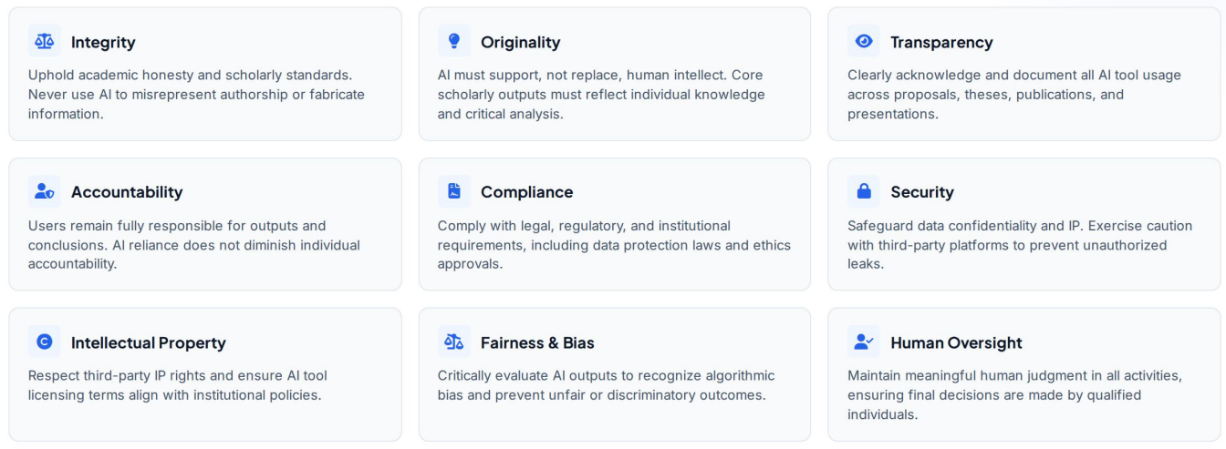
Ethical foundations of (Gen)AI

Slide 12
Assignment
Refer: https://eur-lex.europa.eu/legal-content/EN/TXT/PDF/?uri=OJ:L_202401689
Task: Prepare a 5-page report on the following
    Key concerns raised
    How the concerns are addressed
    What additional guardrails/regulations will be required and why.

